Slide 1

AP 1201 Chapter 6
Temperature and Heat (Chapter 17 of textbook)

Slide 2
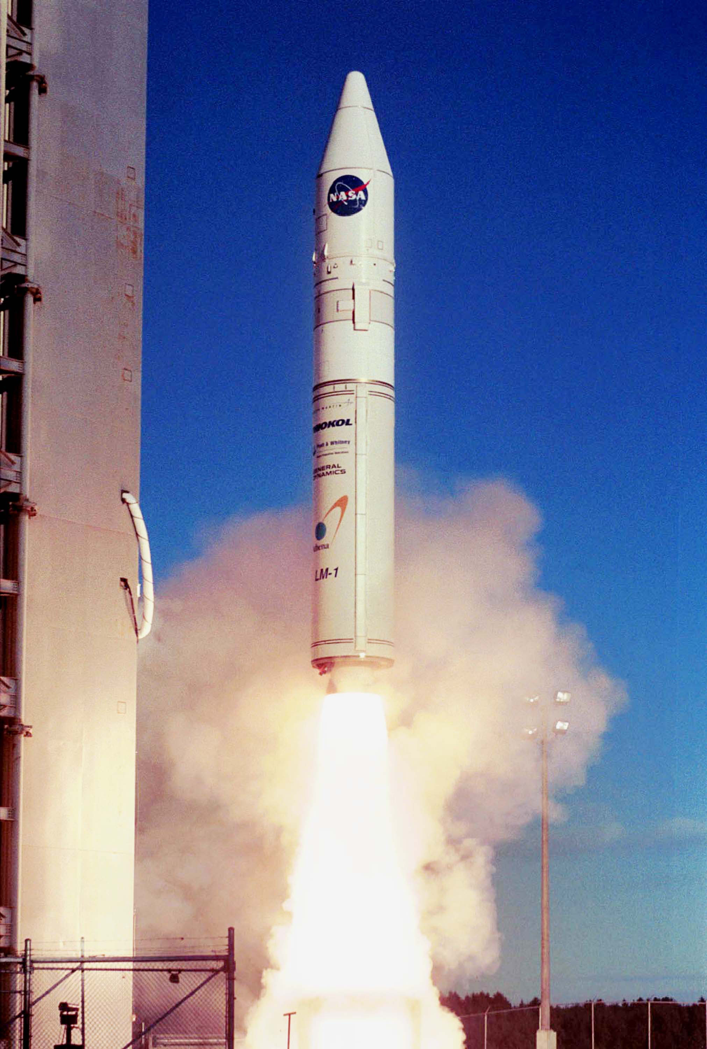
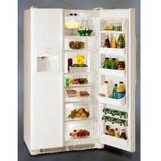
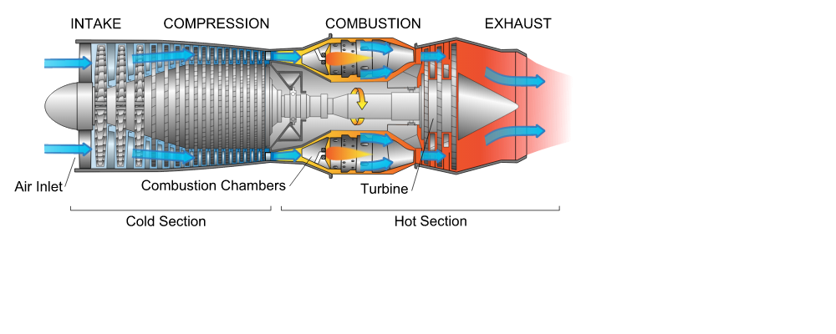
Why do we need to study heat?
Heat has many applications:
Not just cooking food, keep us warm
In engines, engines use heat from burning fuel
Car engines, rocket, jet engines, power generation “use heat”
Air conditioner, refrigerator transfer heat causes change in temperature

Slide 3
topics
Temperature, thermal equilibrium and thermometers
how temperature affects the dimensions of an object
understand the meaning of heat
understand heat flow, temperature changes, and phase changes
understand conduction, convection, and radiation of heat

Slide 4
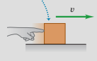
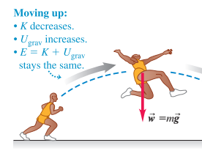
What is Heat?
Heat is a form of energy which is associate with hot objects (unit=J)
Heat is energy transferred from hot object to cold object
Fire is hot, your body is cold, you are warmed up by receiving heat energy from the hot fire
Like kinetic energy and potential energy learned in chapter 4

Slide 5
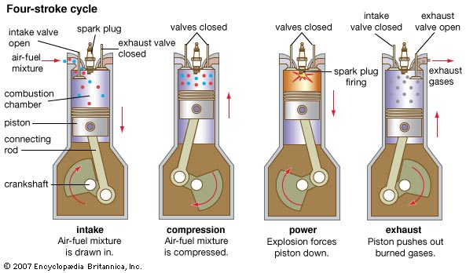
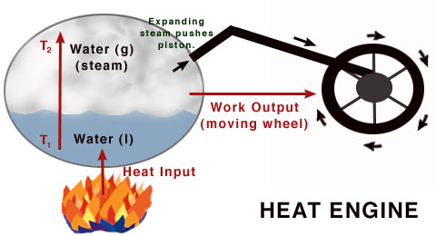
How do we use Heat?
We use heat energy from a hot object or hot objects, not just for cooking or warmth. Cooking is just one application
In engine, we burn fuel to heat up the gas to cause expansion which drive the motion, heat converted to work done
In steam engine, we burn fuel to heat up water to create steam which drives the wheel, heat converted to work done

Slide 6
Hotness and Temperature
Heat is very useful
We need to know how to control heat
hot objects give out heat
We need to define and measure hotness
Hotness is represented by a physical quantity called temperature, which tells you the degree of hotness

Slide 7
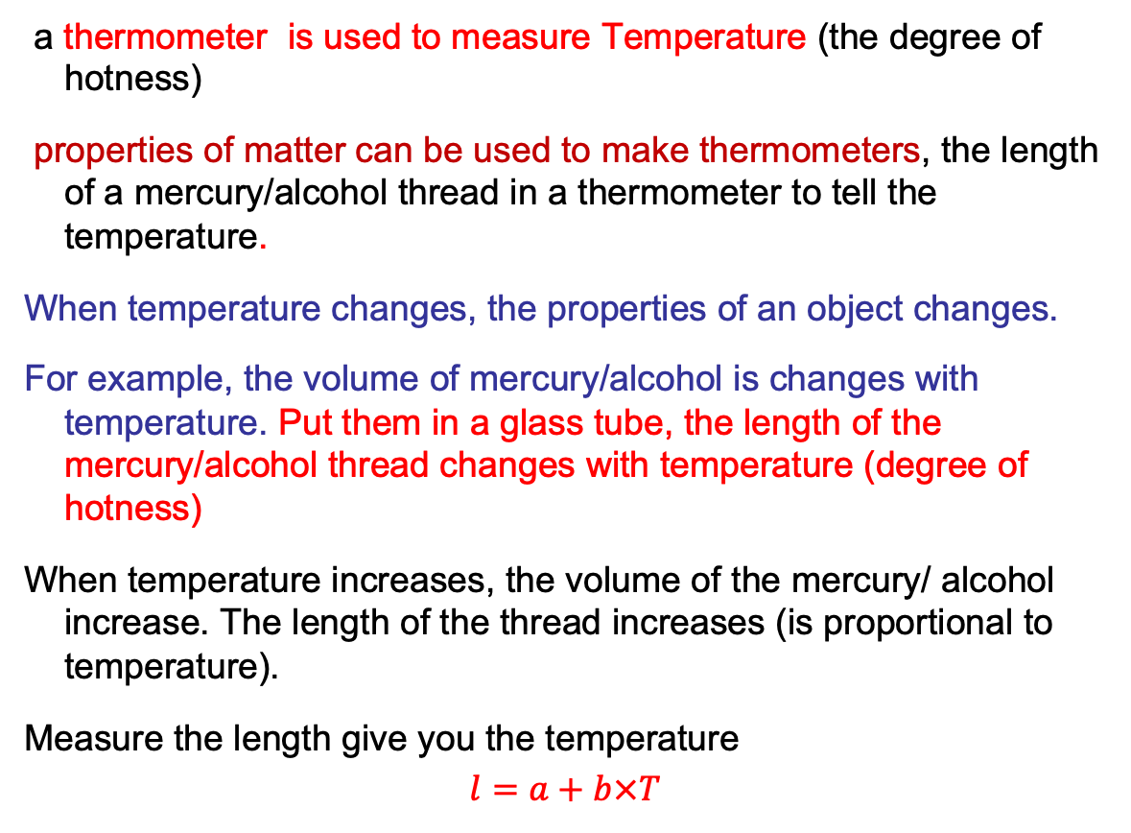
Temperature and Thermometer
a thermometer is used to measure Temperature (the degree of hotness)
properties of matter can be used to make thermometers, the length of a mercury/alcohol thread in a thermometer to tell the temperature.
When temperature changes, the properties of an object changes.
For example, the volume of mercury/alcohol is changes with temperature. Put them in a glass tube, the length of the mercury/alcohol thread changes with temperature (degree of hotness)
When temperature increases, the volume of the mercury/ alcohol increase. The length of the thread increases (is proportional to temperature).
Measure the length give you the temperature
$$l=a+b×T$$

Slide 8
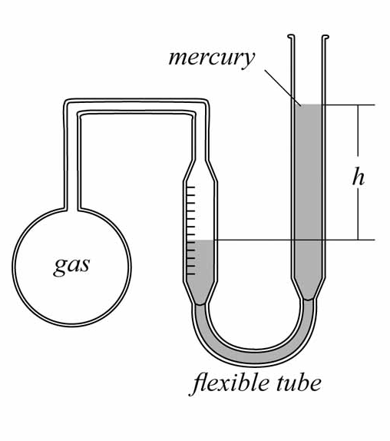
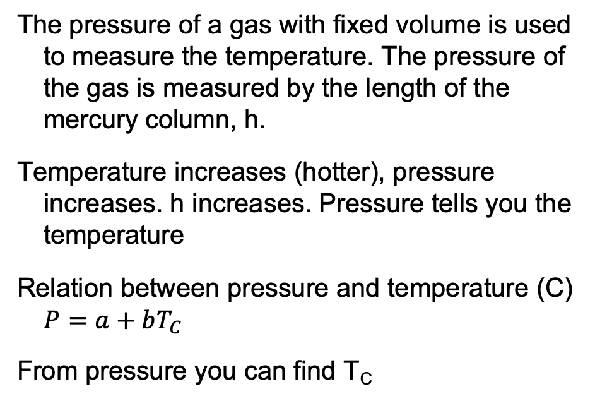
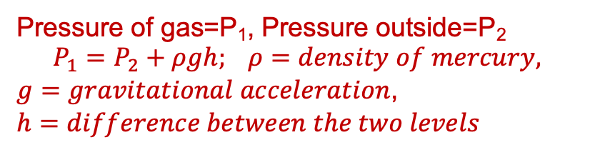
Gas Thermometer
The pressure of a gas with fixed volume is used to measure the temperature. The pressure of the gas is measured by the length of the mercury column, h.
Temperature increases (hotter), pressure increases. h increases. Pressure tells you the temperature
Relation between pressure and temperature (C) $P=a+bT_{C}$
From pressure you can find T_{C}
Pressure of gas=P₁, Pressure outside=P₂
$$P_{1}=P_{2}+ρgh; ρ=density of mercury,$$
$g=gravitational acceleration$,
$h=difference between the two levels$

Slide 9
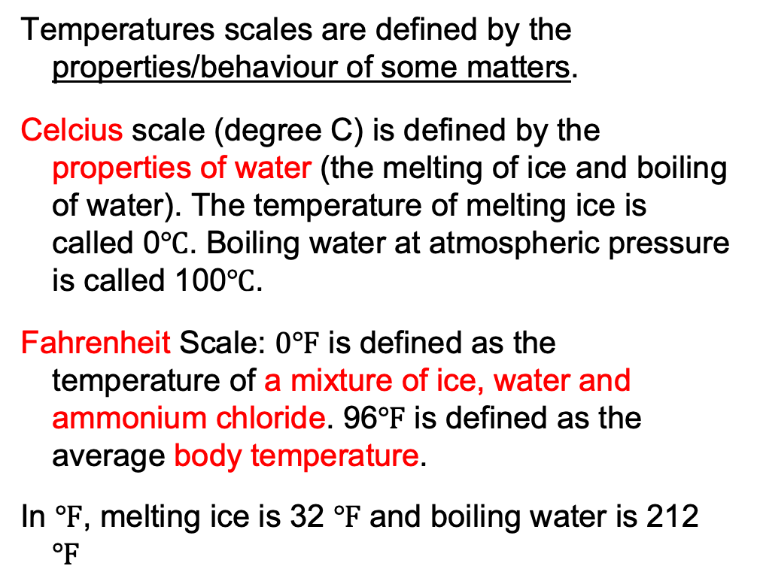
Definitions of temperature scales
Temperatures scales are defined by the properties/behaviour of some matters.
Celcius scale (degree C) is defined by the properties of water (the melting of ice and boiling of water). The temperature of melting ice is called 0$℃$. Boiling water at atmospheric pressure is called 100$℃$.
Fahrenheit Scale: $0℉$ is defined as the temperature of a mixture of ice, water and ammonium chloride. 96$℉$ is defined as the average body temperature.
In $℉$, melting ice is 32 $℉$ and boiling water is 212 $℉$

Slide 10
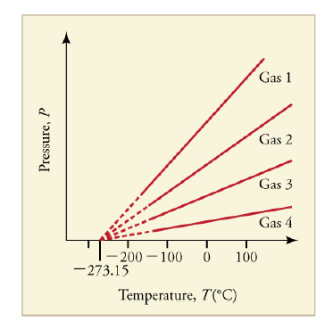
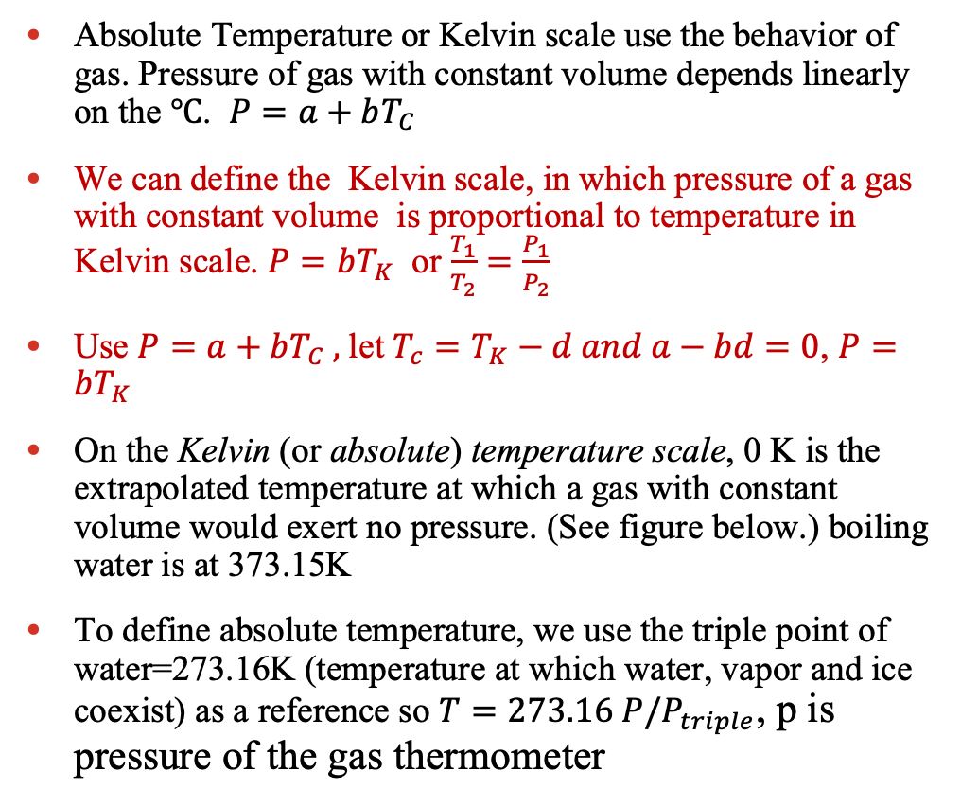
Absolute Temperature scale
Absolute Temperature or Kelvin scale use the behavior of gas. Pressure of gas with constant volume depends linearly on the $℃$. $P=a+bT_{C}$
We can define the Kelvin scale, in which pressure of a gas with constant volume is proportional to temperature in Kelvin scale. $P=bT_{K}$ or $\frac{T_{1}}{T_{2}}=\frac{P_{1}}{P_{2}}$
Use $P=a+bT_{C} ,$let $T_{c}=T_{K}−d and a−bd=0$, $P=bT_{K}$
On the Kelvin (or absolute) temperature scale, 0 K is the extrapolated temperature at which a gas with constant volume would exert no pressure. (See figure below.) boiling water is at 373.15K
To define absolute temperature, we use the triple point of water=273.16K (temperature at which water, vapor and ice coexist) as a reference so $T=273.16 P/P_{triple}$, p is pressure of the gas thermometer
We use K to describe ideal gas behavior as it simplifies the gas law expression

Slide 11
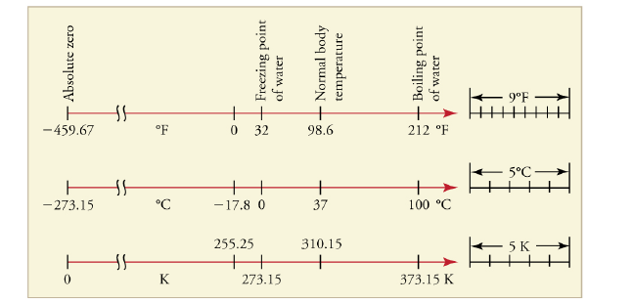
Temperature conversions
The following conversion equations are useful:
T_{F} = 9/5 T_{C} + 32° ; T_{C} = 5/9 (T_{F} – 32°) ; T_{K} = T_{C} + 273.15
The chart below shows the relationship between temperature scales

Slide 12
Temperature and Direction of heat flow
When we put hot and cold objects together, they will gradually become having the same temperature.
Cold ice in a hot drink will melt and the drink will have one temperature
Explanation: hot object will give out heat to cold object and raise the temperature of the cold object and the hot object becomes colder
heat flow from hot objects (high temperature) to cold objects (low temperature)
hot objects (high temp) transfer heat energy to cold objects (low temp) . Cold objects gain energy from hot objects

Slide 13
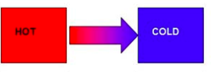
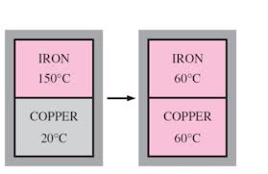
“Thermal Equilibrium”
When two objects have different temperature, there is heat flow (energy flow) between the two objects.
When they have the same temperature,. they are in thermal equilibrium. There is no heat flow between two objects in thermal equilibrium
Iron in high temperature in contact with copper, which has a lower temperature
Heat transferred from iron to copper.
Copper receives heat and temperature increases, until copper has same temperature as iron (until the copper and iron are in thermal equilibrium)
Heat flow from hot to cold
Notes:
What is temperature, what is thermal equilibrium

Slide 14
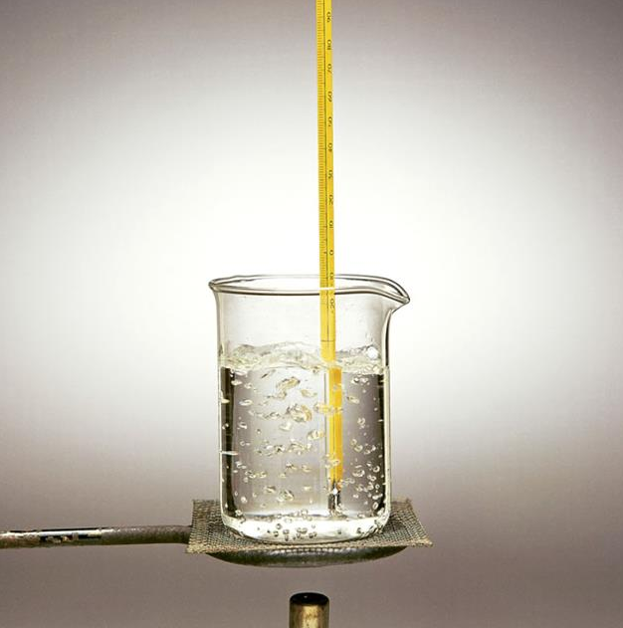
Thermal equilibrium in temperature measurement
When you measure the temperature of the water using a thermometer,
We wait for a while after putting the thermometer in water so that heat is exchanged between water and thermometer.
After sufficient heat exchange, water and thermometer are in thermal equilibrium.
At thermal equilibrium there is no heat exchange between water and thermometer.
At thermal equilibrium, Temperature of the thermometer is same as the temperature of water
When measure temperature, the thermometer and the object measured are in thermal equilibrium

Slide 15
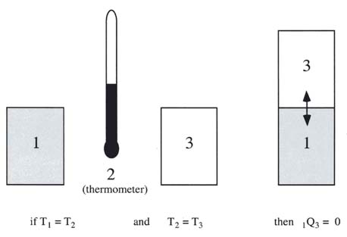
The zeroth law of thermodynamics
Zeroth law of thermodynamics: If C is in thermal equilibrium with A and C is in thermal equilibrium with B, then A and B are in thermal equilibrium with each other. (See Figure below.)
When we use thermometer 2 to measure the temperature of 1 and 3, the thermometer 2 is in thermal equilibrium with 1 and 3 separately
When the thermometer 2 tells 1 and 3 have the same temperature, then 1 and 3 are in thermal equilibrium and have the same temperature. When you put them together, there is no heat flow and the temperature remains unchanged.
C 50ºC
A 50ºC
B 50ºC

Slide 16
Consequence of zero law
Owing to zero law, we don’t need to bring two objects together and still know that they are in thermal equilibrium,
We know that when they have the same temperature measured with the same thermometer, they are in thermal equilibrium

Slide 17
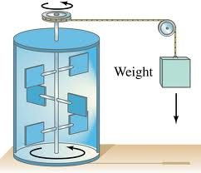
Heat is energy: Experimental Proof
Heat from hot objects to cold objects and causes temperature increase in the cold object
Heat is a form of energy, it is measured in joule, just like kinetic energy, potential energy
Experimental proof:
The weight falls, decrease in potential energy, convert to work done by stirrer
Temperature of water increase, water have heat energy
Heat energy come from work done and potential energy. Heat is a form of energy like KE and PE

Slide 18
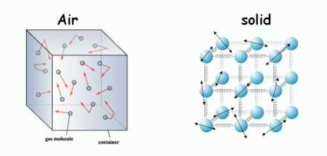
Atomic/molecular model of matter and Internal Energy
Objects can transfer energy to other colder objects. Matter has internal energy.
Matters consist of atoms and molecules, which are in random motion
The atoms or molecules possess random kinetic energy. When temperature increase, random kinetic energy increases.
The total random kinetic energy is part of the internal energy of the matter. The other part is the potential energy due to interatomic force.
Between atoms/molecules there is potential energy due to interatomic forces (attractive or replusive)
Internal energy =random kinetic energy+inter-molecular potential energy

Slide 19
Internal energy and heat
When temperature increases, random kinetic energy increases, inter-atomic/molecular potential energy increases,
Which means internal energy increases
You need to supply energy to increase the internal energy and the temperature of the objects.
This energy is called heat
Thus Heat is energy like kinetic energy and potential energy

Slide 20
Thermal state
State of an object determined by its temperature is the thermal state of the object
For example:
Temperature increases, solids expand, liquid boils, gas expands, ice melt, iron becomes softer
change in temperature>change in thermal state> change in properties
The changes due to change in temperature is the changes of the thermal state

Slide 21
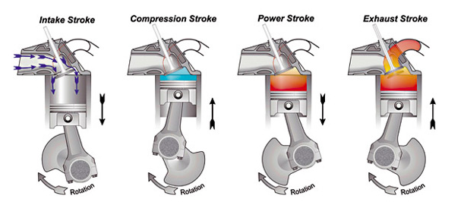
State variable
State variable is a physical quantity that determines the thermal state of an object. Change in thermal state leads to change in state variables
Temperature is a state variable, it describes thermal state of matter. Other state variables: pressure, volume.
Position is state variable in mechanics, position is used to describe the change of positions of objects
In heat engine (car engine), matter changes its state (describe by state variables) through a cycle and convert heat into mechanical work. Temperature is changed in a cycle.
We use the change of thermal states of gas in a car engine

Slide 22
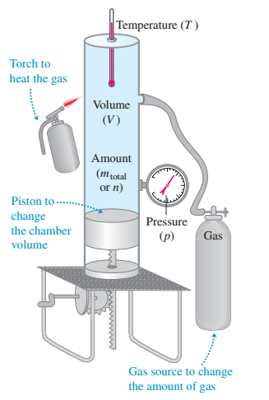
Other state variables
Pressure, volume, length are also other state variables.
When the thermal state is changed, state variables, such as temperature, volume, pressure and length, can change.
They describe change in the state of the matter; So they are state variables.
State variables are used to describe the thermal state of matter just like position, velocity and acceleration in motion.
For example, temperature increases pressure increases is a change of thermal state

Slide 23
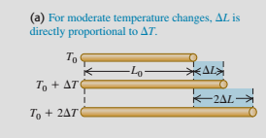
Thermal expansion (change in thermal state)
When an object changes its temperature, its thermal state is changed
Its properties are changed
Its dimension is changed. This is thermal expansion
When the temperature is increased, the length of an object is longer.

Slide 24
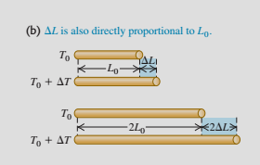
Linear thermal expansion
Increasing the temperature of a rod causes it to expand (see figure at the right).
The change in length is given by ΔL = αL₀ ΔT, where α is the coefficient of linear expansion of the material.
Expanded length:

Slide 25
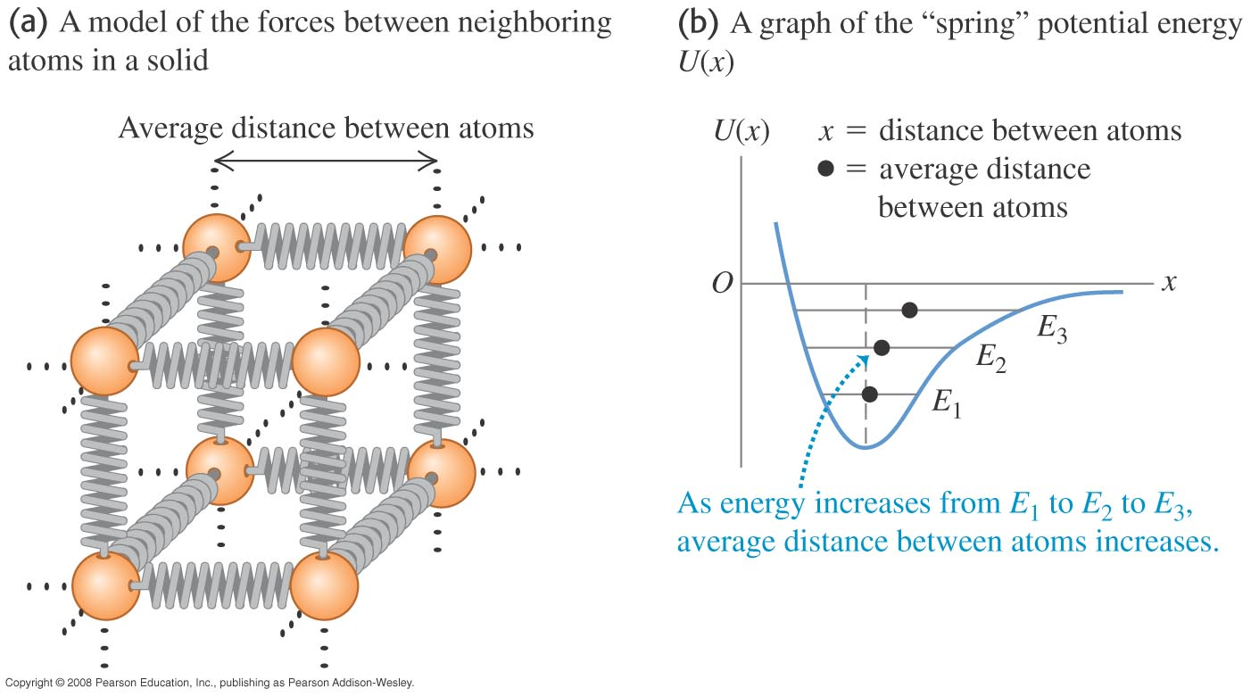
Thermal expansion: Molecular/Atomic Model of matters
Matters consist of atoms or molecules
Atoms and molecules are in constant random motion (random thermal motion)
In solids, atoms/molecules are bound together by interatomic/intermolecular forces
The interatomic force give rise to interatomic potential energy
when they are closer, they repel. (PE increase)
When they are pull apart they attracts each other (PE increase).
PE is minimum when the interatomic force is zero.

Slide 26
Molecular basis for thermal expansion
Repulsive force (compress) between atoms is stronger than the attractive force (pull apart). The interatomic force produces a potential well that traps the atoms so that they don’t fly away
This potential well is not symmetrical
Asymmetric
Potential well

Slide 27
Atomic explanation of thermal expansion
Atoms are oscillating within the binding potential well (which is not symmetric)
We only see their average position.
The black dots in the figures shows the average positions for different potential energy
Temperature is higher, higher potential energy (E₂>E₁) , average distance increases due to the asymmetry in the potential well

Slide 28
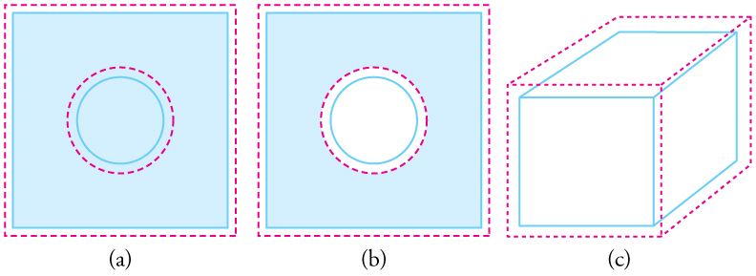
Expanding holes and volume expansion
If an object has a hole in it, the hole also expands with the object, as shown in figure at the right. The hole does not shrink.
The change in volume due to thermal expansion is given by ΔV = βV₀ ΔT, where β is the coefficient of volume expansion and is equal to 3α.

Slide 29
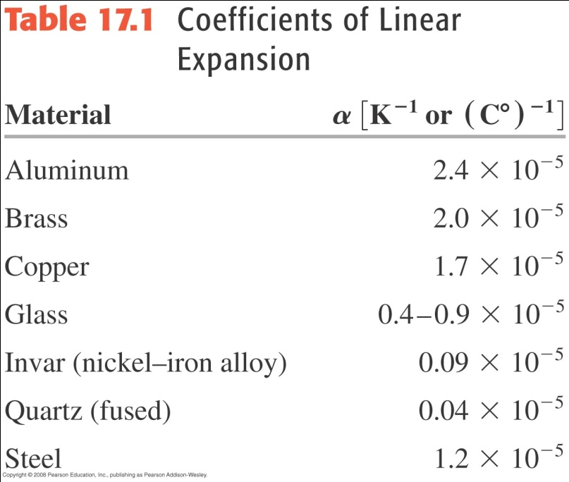
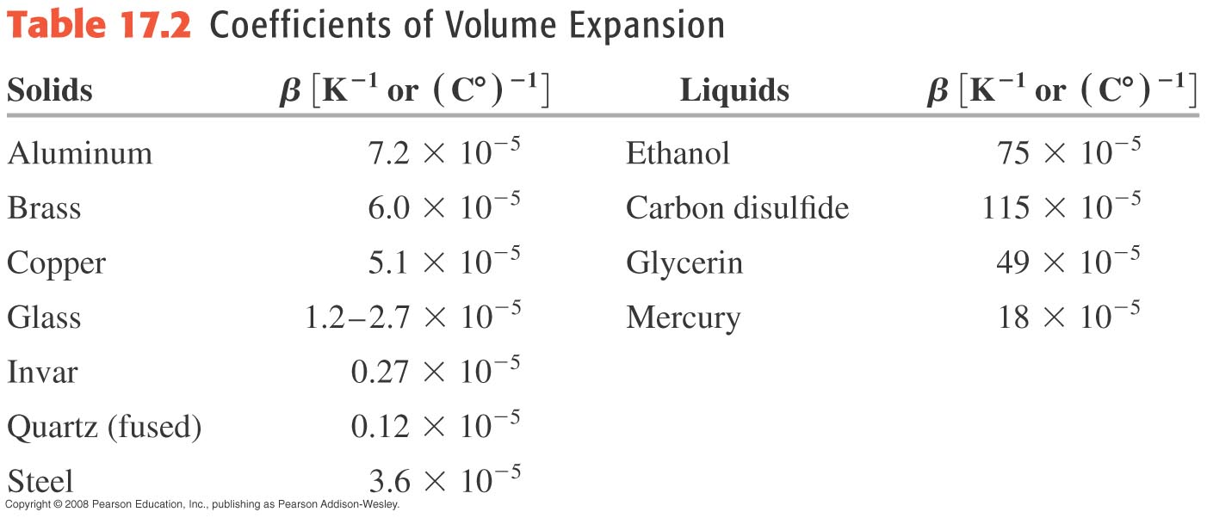
Coefficients of expansion
The two tables show the coefficients of linear and volume expansion for some materials.

Slide 30
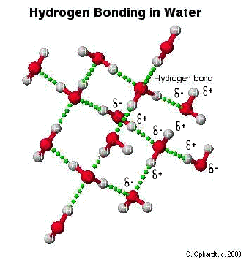
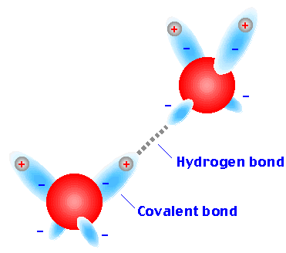
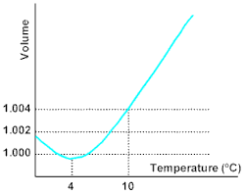
Thermal expansion of water
Between 0°C and 4°C, water decreases in volume with increasing temperature (increase in volume with decrease in temperature)
Water becomes ice owing to the hydrogen bond between molecules. The hydrogen is strong in some directions.
When the solid is formed, water expands.
Because of this anomalous behavior, lakes freeze from the top down instead of from the bottom up.
Figure at the right illustrates this behavior.

Slide 31
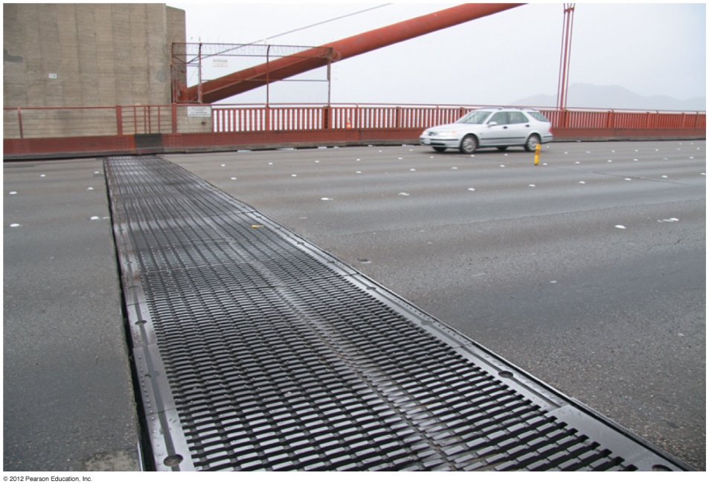
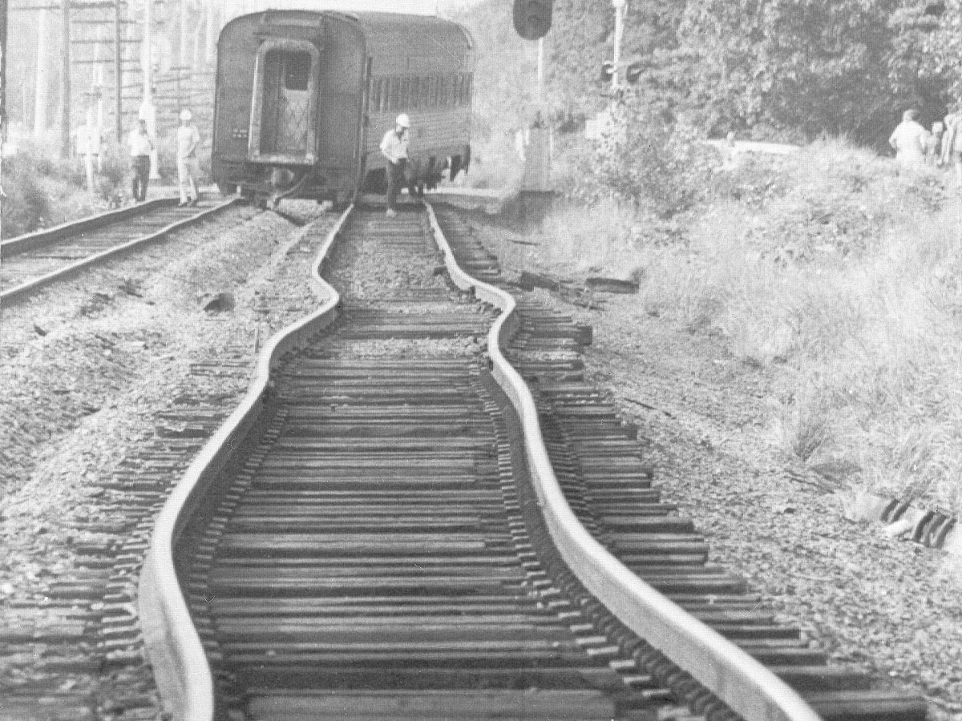
Why the bridge has a gap? Why the tracks are bent?
gap

Slide 32
Thermal stress
If we change the temperature of a rod but prevent it from expanding or contracting, you need to apply force on the two ends to prevent it moves.
thermal stress develops as the rod is compressed under a force
The thermal stress is
Y: Young’s modulus
gap

Slide 33
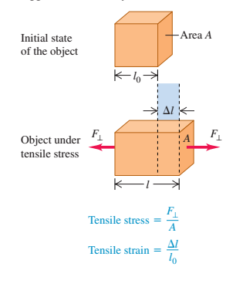
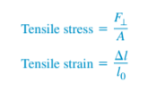
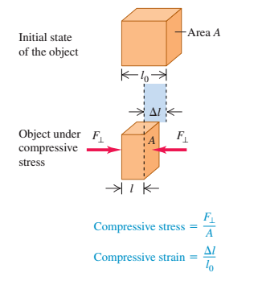
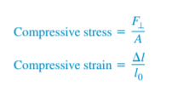
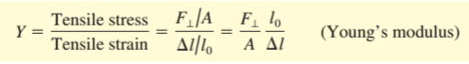
Stress
Apply a force on a rod/object, stress is applied to the rod/object
The object is shortened/lengthened (strain is produced)
Length is shortened, compressive stress and compressive strain
Length is lengthened, tensile stress and tensile strain
Stress=force/area
Strain=change in length/length

Slide 34
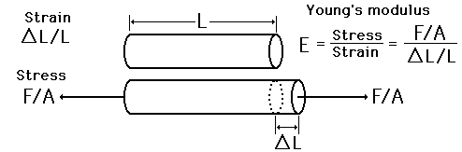
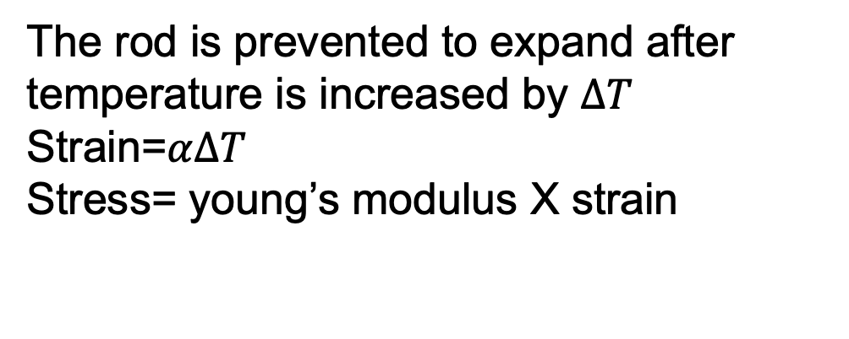
The rod is prevented to expand after temperature is increased by $ΔT$
Strain=$αΔT$
Stress= young’s modulus X strain
Negative for compressive stress
Y

Slide 35
The gap in the bridge allows the bridge to expand so there is no thermal stress
If there is no gap, the bridge could be deformed by the stress, just like the tracks, which are bent
gap

Slide 36
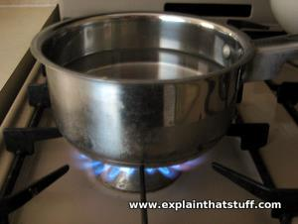
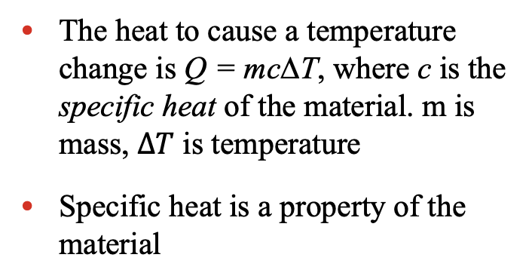
Quantity of heat for temperature change
The heat to cause a temperature change is Q = mcΔT, where c is the specific heat of the material. m is mass, $ΔT$ is temperature
Specific heat is a property of the material
For an inﬁnitesimal temperature change dT and corresponding quantity of heat dQ:

Slide 37
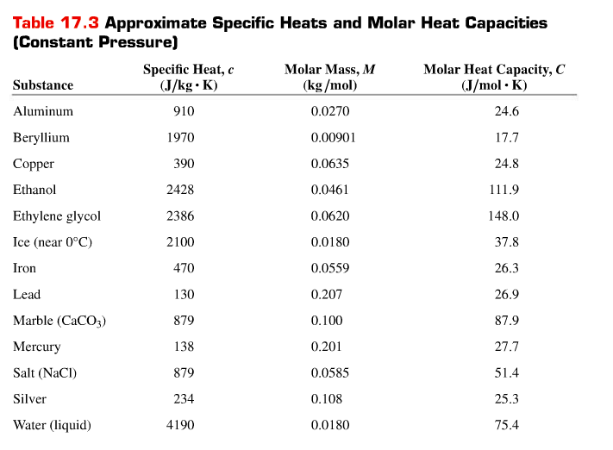
Specific heat

Slide 38
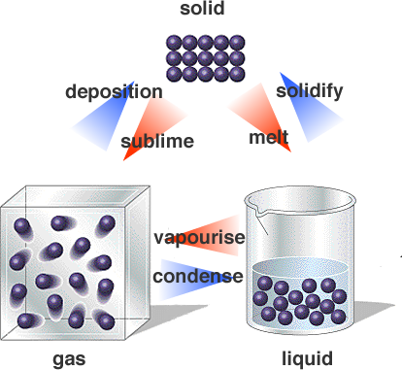
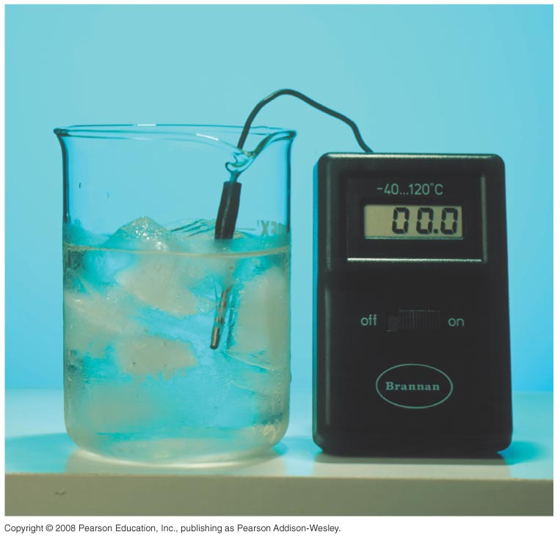
Phase changes
The phases (or states) of matter are solid, liquid, and gas. Different phases mean different properties
A phase change is a transition from one phase to another.
The temperature does not change during a phase change (see figure at the right).
The heat of fusion, L_{f}, is the heat per unit mass that is transferred in a solid-liquid phase change. The heat of vaporization, L_{v}, is the heat per unit mass transferred in a liquid-gas phase change.
The heat transferred in a phase change is Q = ±mL. (L can be L_{v} or L_{f})
Table on the next slide shows some examples of heats of fusion and vaporization.
Water and coexist
Same temperature at phase change

Slide 39
Solid changes to liquid requires latent heat of fusion (atoms in solid are more tightly bound than in liquid) energy is needed to help atoms break the bonding
Liquid changes to solid gives out latent heat of fusion (energy release from bonding)
Liquid changes to vapor requires latent heat of vaporization (atoms in liquid are more tightly bound than in vapor)
Vapour changes to liquid gives out latent heat of vaporization
latent heat of fusion
latent heat of vaporization

Slide 40
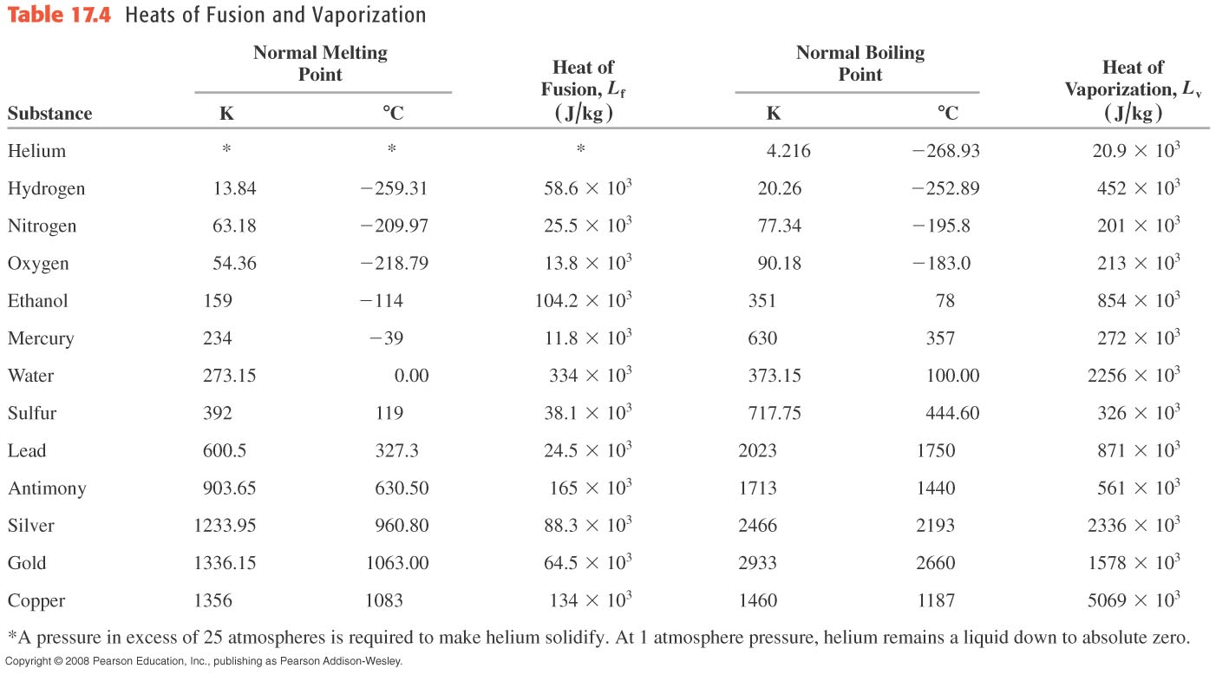
Heats of Fusion and Heats of Vaporization

Slide 41
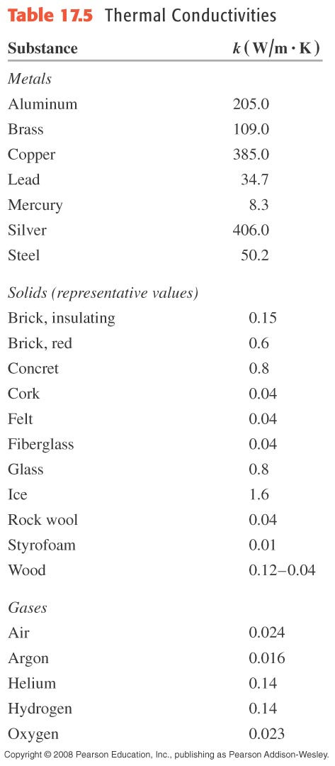
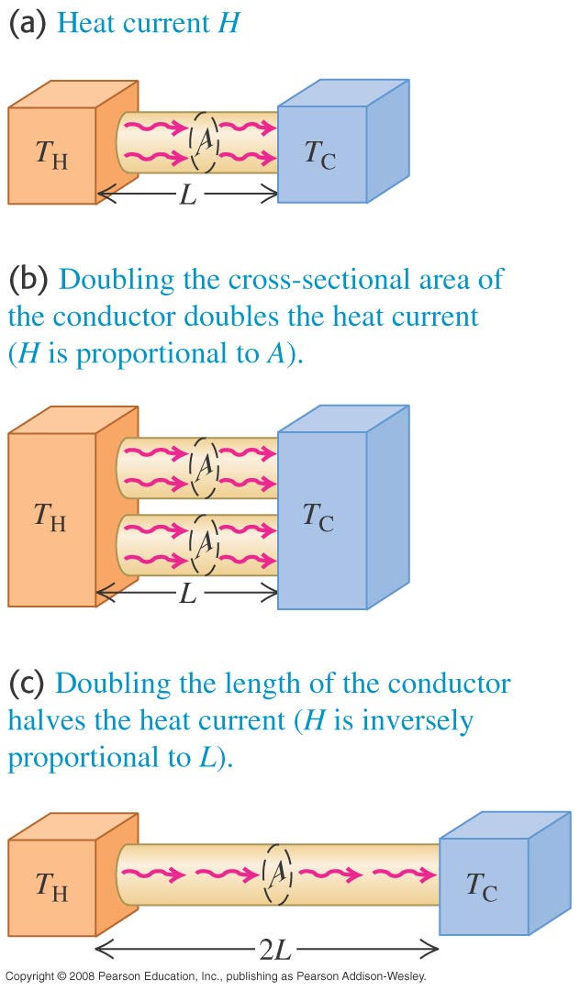
Conduction of heat
Heat can move from high to low temperature
Conduction occurs between bodies in contact.
Figure at the right illustrates steady-state heat flow.
The heat current is
H = dQ/dt = kA(T_{H} – T_{C})/L.
Table at right lists some thermal conductivities, k.

Slide 42
Heat conduction mechanism
When temperature increases, atoms moves more rapidly, internal energy of the region is increased
These rapidly moving atoms cause neighbouring atoms to move more rapidly.
Energy in neighbouring region increases as atoms move faster, energy is transferred to neighbouring region.
Temperature of neighbouring region increases as result.

Slide 43
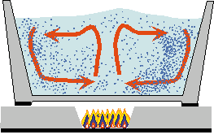


Convection of heat
Convection is the transfer of heat by the mass motion of fluid.
When temperature increases, liquid/gas expand (volume increase) density decreased (become lighter), hotter fluid/gas move up and move to the cold area.
Cold fluid/gas sink down and it is replaced by hot fluid/gas

Slide 44



Radiation emitted by objects
Objects has non-zero temperature can emit radiation
Low temperature objects emit invisible light like infra red (they can be detected by infrared camera)
High temperature objects emit visible light and invisible light
Light(radiation) is a form of energy transfer

Slide 45

Radiation of heat
Radiation is the transfer of heat by electromagnetic waves, such as visible light or infrared.
Figure at the right is a false-color infrared photo in which red is the strongest emission.
Stefan-Boltzmann law: The heat current in radiation is
The net rate of radiation from a body at temperature T with surrounding at T_{s} is:

Slide 46
A is area
e is emissitivity, depending on the properties of the surface
σ is stefan-Boltzman constant 5.67x10⁻⁸ W/m²K⁴

Slide 47

Radiation and climate change
The energy radiated by the earth’s surface is mostly infrared.
CO₂ molecules in our atmosphere readily absorb some of this infrared radiation and reradiate part of it back down toward the surface. This increases the temperature of the surface. This effect is called the greenhouse effect.
Figure below shows how the increase in global temperature is correlated with the rise in CO₂ emission.

Slide 48

Some examples of thermal expansion
Example 17.2: Linear expansion of a steel measuring tape
A surveyor uses a steel measuring tape that is exactly 50.000 m
long at a temperature of 20°C. The markings on the tape are cali-
brated for this temperature. (a) What is the length of the tape when
the temperature is 35°C? (b) When it is 35°C, the surveyor uses the
tape to measure a distance. The value that she reads off the tape is
35.794 m. What is the actual distance?
SOLUTION

Slide 49


Some examples of thermal expansion
Example 17.2: Linear expansion of a steel measuring tape

Slide 50



Some examples of thermal expansion
Example 17.3: Volume expansion of a liquid and a solid.
A 200-cm³ glass ﬂask is ﬁlled to the brim with mercury at 20ºC
How much mercury overﬂows when the temperature of the system
is raised to 100ºC? The coefﬁcient of linear expansion of the glass
is 0.40X10⁻⁵ K⁻¹.
SOLUTION

Slide 51



Example 17.4: Thermal stress
An aluminum cylinder 10 cm long, with a cross-sectional area of 20 cm², is used as a spacer between two steel walls. At 17.2°C it just slips between the walls. Calculate the stress in the cylinder and the total force it exerts on each wall when it warms to 22.3°C, assuming that the walls are perfectly rigid and a constant distance apart.
SOLUTION

Slide 52

Quantity of heat
Example 17.5: Feed a cold, starve a fever
During a bout with the ﬂu an 80-kg man ran a fever of 39.0°C instead of the normal body temperature of 37.0°C. Assuming that the human body is mostly water, how much heat is required to raise his temperature by that amount?
SOLUTION

Slide 53

Quantity of heat
Example 17.6: Overheating electronic
You are designing an electronic circuit element made of 23 mg of silicon. The electric current through it adds energy at the rate of 7.4 mW = 7.4*10⁻³J/s. If your design doesn’t allow any heat transfer out of the element, at what rate does its temperature increase? The speciﬁc heat of silicon is 705 J kg⁻¹ K⁻¹.
SOLUTION

Slide 54



Heat calculations
Example 17.7: A temperature change with no phase change
A camper pours 0.300 kg of coffee, initially in a pot at 70ºC into a 0.120-kg aluminum cup initially at 20ºC. What is the equilibrium temperature? Assume that coffee has the same speciﬁc heat as water and that no heat is exchanged with the surroundings.
SOLUTION

Slide 55


Heat calculations
Example 17.8: Changes in both temperature and phase
A glass contains 0.25 kg of Omni-Cola (mostly water) initially at 25°C. How much ice, initially at -20°C must you add to obtain a ﬁnal temperature of 0°C with all the ice melted? Neglect the heat capacity of the glass.
SOLUTION

Slide 56

Heat calculations
Example 17.9: What’s cooking?
A hot copper pot of mass 2.0 kg (including its copper lid) is at a temperature of 150°C. You pour 0.10 kg of cool water at 25°C into the pot, then quickly replace the lid so no steam can escape. Find the ﬁnal temperature of the pot and its contents, and determine the phase of the water (liquid, gas, or a mixture). Assume that no heat is lost to the surroundings.
SOLUTION

Slide 57



Heat calculations
Example 17.9: What’s cooking?

Slide 58



Heat calculations
Example 17.10: combustion, temperature change, and phase change
In a particular camp stove, only 30% of the energy released in burning gasoline goes to heating the water in a pot on the stove. How much gasoline must we burn to heat 1.00 L (1.00 kg) of water from 20°C to 100°C and boil away 0.25 kg of it?
SOLUTION

Slide 59




Example 17.11: Conduction into a picnic cooler
A Styrofoam cooler in the figure has total wall area (including the lid) of 0.80 m² and wall thickness 2.0 cm. It is ﬁlled with ice, water, and cans of Omni-Cola, all at 0°C.What is the rate of heat ﬂow into the cooler if the temperature of the outside wall is 30°C? How much ice melts in 3 hours?
SOLUTION

Slide 60




Conduction through two bars that are end-to-end
Example 17.12: Conduction through two bars I
A steel bar 10.0 cm long is welded end to end to a copper bar 20.0 cm long. Each bar has a square cross section, 2.00 cm on a side. The free end of the steel bar is kept at 100ºC by placing it in contact with steam, and the free end of the copper bar is kept at 0ºC by placing it in contact with ice. Both bars are perfectly insulated on their sides. Find the steady-state temperature at the junction of the two bars and the total rate of heat ﬂow through bars.
SOLUTION

Slide 61



More conduction through two bars
Example 17.13: Conduction through two bars II (bars arranged differently)
Suppose the two bars of Example 17.12 are separated. One end of each bar is kept at 100°C and the other end of each bar is kept at 0°C. What is the total heat current in the two bars?
SOLUTION

Slide 62


Radiation of heat
Example 17.15: Radiation from the human body
What is the total rate of radiation of energy from a human body with surface area 1.20 m² and surface temperature 30°C = 303 K? If the surroundings are at a temperature of 20°C, what is the net rate of radiative heat loss from the body? The emissivity of the human body is very close to unity, irrespective of skin pigmentation.
SOLUTION

Slide 63

TQ6.1
The illustration shows a thermometer that uses a column of liquid (usually mercury or ethanol) to measure air temperature. In thermal equilibrium, this thermometer measures the temperature of
A. the column of liquid.
B. the glass that encloses the liquid.
C. the air outside the thermometer.
D. both A. and B.
E. all of A., B., and C.

Slide 64
TQ6.2
A sample of a low-density gas is initially at room temperature and has pressure p₀. The gas is warmed at constant volume until the pressure is 2p₀.
Compared to the initial Celsius temperature of the gas, the final Celsius temperature is
A. greater by a factor of more than 2.
B. greater by a factor of 2.
C. greater by a factor between 1 and 2.
D. the same.
E. less.

Slide 65
TQ6.3
A solid object has a hole in it. Which of these illustrations more correctly shows how the size of the object and the hole change as the temperature increases?
#1
#2
A. illustration #1
B. illustration #2
C. The answer depends on the material of which the object is made.
D. The answer depends on how much the temperature increases.
E. Both C. and D. are correct.

Slide 66
TQ6.4
A pitcher contains 0.50 kg of liquid water and 0.50 kg of ice at 0°C. You let heat flow into the pitcher until there is 0.75 kg of liquid water and 0.25 kg of ice. During this process,
A. the temperature of the ice-water mixture increases slightly.
B. the temperature of the ice-water mixture decreases slightly.
C. the temperature of the ice-water mixture remains the same.
D. The answer depends on the rate at which heat flows.

Slide 67
TQ6.5
A chair has a wooden seat but metal legs. The chair legs feel colder to the touch than does the seat. Why is this?
A. The metal is at a lower temperature than the wood.
B. The metal has a higher specific heat than the wood.
C. The metal has a lower specific heat than the wood.
D. The metal has a higher thermal conductivity than the wood.
E. The metal has a lower thermal conductivity than the wood.

Slide 68
TQ6.6
When you first step out of a swimming pool on a warm day, you feel cool. This is due primarily to
A. conduction.
B. convection.
C. radiation.
D. All three of these are equally important.

